Slide 1


2013-2014 Student Internship/Co-op and Full-Time Outcome Report
Prepared By
Career & Corporate Connections

Slide 2
Smeal College Outcomes 2013-2014
Outcomes upon Graduation | Full-Time offers, Continuing to Graduate School, Military, Entrepreneurship, Public Service | Average Salary per Major (outliers excluded) | Students with Internships who are Employed Full-time
Overall | 77% | $54,700 | 92%
Accounting | 80% | $54,705 | 93%
Actuarial Science/ RM Actuarial Science | 85% | $62,308 | 92%
Finance | 83% | $57,908 | 95%
MIS | 86% | $57,195 | 92%
Management | 76% | $47,852 | 78%
Marketing | 65% | $48,648 | 92%
Risk Management (REST) | 78% | $46,900 | 100%
Risk Management (ERM) | 74% | $58,000 | 96%
Supply Chain | 78% | $55,471 | 92%

Slide 3
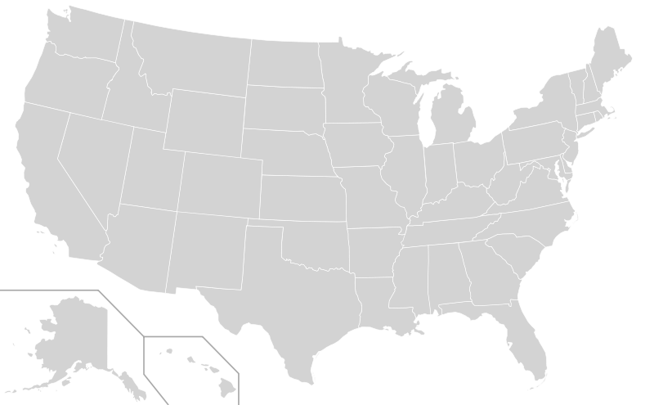
Employer Activity
Top Internship Placements*
PwC
JP Morgan Chase
EY
KPMG
Deloitte
Johnson & Johnson
Goldman Sachs
PNC Financial Services
Bank of America Merrill Lynch
Kohls Department Stores
Dick’s Sporting Goods
Ross Stores
Northwestern Mutual
Target
PepsiCo
GE
Altria
Nordstrom
Macy’s
UBS
Siemens
Top Full-Time Placements*
PwC
Deloitte
EY
JP Morgan Chase & Co
KPMG
PNC
Dick’s Sporting Goods
Goldman Sachs
Amazon.com
PepsiCo
IBM
Bank of America
Vanguard
AXA
Unilever
GE
Geographic Locations
33%
6%
53%
2%
Highlights
2%
2%
Top State Locations Full Time
PA | 37%
NY | 18%
NJ | 10%
VA | 5%
DE | 3%
TX | 3%
MD | 3%
MA | 2%
CA | 2%
OH | 2%
GA | 2%
CT | 2%
DC | 1.5%
Paid Internship Information
Paid Internships | 83%
Average Wage per Hour per Major
Accounting | $21
Finance | $20
MIS | $17
Management | $16
Marketing | $14
Risk Management | $18
Supply Chain & MIS | $17
* Top 15 company placements listed in rank order; More than 15 companies listed due to the same hiring totals
* Top internship placements for the class of 2014 in order of most hires
Methodology
Smeal seniors were surveyed during April 2014 to collect at-graduation student career outcomes. We collected 1,202 out of 1,289 as to their career outcome status upon graduation.
81% of Students reported having at least one Internship during their college career
Smeal Career & Corporate Connections
114 Business Building
http://smeal.psu.edu/corp

