Slide 1
Alumni Engagement Tools
Evaluate.Deploy.Connect.
Catherine Nichols, UNC Kenan-Flagler
Rebecca Ricksen, Berkeley-Haas
Notes:
QUESTION FOR AUDIENCE: What are you looking for an alumni engagement tool to do?
If that doesn’t elicit responses: What comes to mind when hearing “alumni engagement tool?”

Slide 2
what are you using?
Symplicity
Affinity Circles
IntroMaps
LinkedIn/ social media
iModules
EverTrue
NationBuilder
Blackbaud
Convio
Ungerboeck
Givegab
GradMap
QuadWrangle
VolunteerCampaigns/Orbees
Notes:
Show of hands for listed tools, invite additions

Slide 3
macro | micro
engagement
philanthropy
communication
chasing the magic triangle
Notes:
Haas AR’s main mantra is engage, inspire, invest, and we ask our alumni volunteers to do the same in their work
Seeking to better leverage peer:peer encouragement and solicitations in upcoming year

Slide 4
macro | micro
 | EverTrue | GiveGab | GradMap | NationBuilder | QuadWrangle
1:1 communication | X | X | X | X
1:many communication |  | X | X | X | X
Event management |  | X |  | X
Multiple engagement levers (class, region, org.) | X |  | X | X | X
Lifecycle application | X | X | X | X | X
Realtime donation integration | X | TBD | X | X | X
External/internal environments | X | X | X | X | X
Fundraising tool | X |  | X | X | X
Bio update API with alumni database | X |  | X | X | X
Social sign-on | X | X | X | X | X

Slide 5
case 1: Kenan-Flagler
Kenan-Flagler Online Community Tools – Harris Connect/iModules
Online Alumni Directory – enrolled students and alumni have access
Basic alumni search
Advanced alumni search
Global word search
Class notes – searchable by year, degree, note type
Alumni Club pages – manage by AR
Events listing and guest registration
Universal email forwarding – lifelong email address – catnichols@uncbusiness.net
Alumni profile management – update information, select information to be on display, attach resume
Broadcast Email for managing and sending communications
iModules discontinuing support of Harris online tools in 2015
UNC’s General Alumni Association driving force for new system. Coordination of services with GAA, central development and constituency schools.

Slide 6
case 1: Kenan-Flagler
Kenan-Flagler is currently exploring
Total system replacement - iModules or Symplicity
In-house system coupled with other tools
In-house online directory & class notes
Additional tools
EverTrue – alumni engagement and directory
QuadWrangle – alumni engagement and directory
IntroMaps – alumni engagement and directory
Ungerboeck – events management

Slide 7
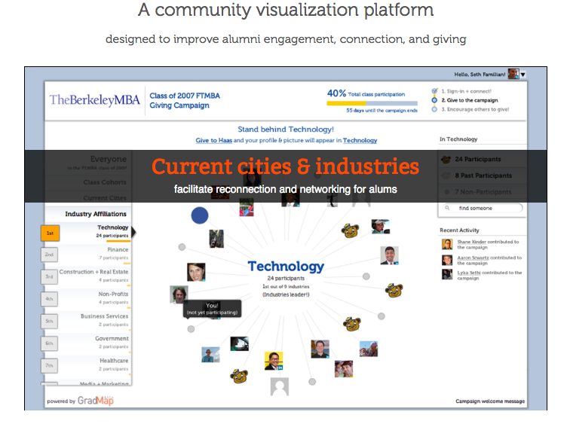
case 2: Haas + GradMap
Visual directory, interactive giving platform, event pre-connection tool
95% login by MBA new admits before Orientation
Real-time campaign participation tracking
New pricing model
Notes:
30-second history of GradMap
Micro + Haas-branded community
Engagement + fundraising + communication
[awaiting slides from Seth]

Slide 8
case 2: Haas + GradMap
Notes:
30-second history of GradMap
Micro + Haas-branded community
Engagement + fundraising + communication
[awaiting slides from Seth]

Slide 9
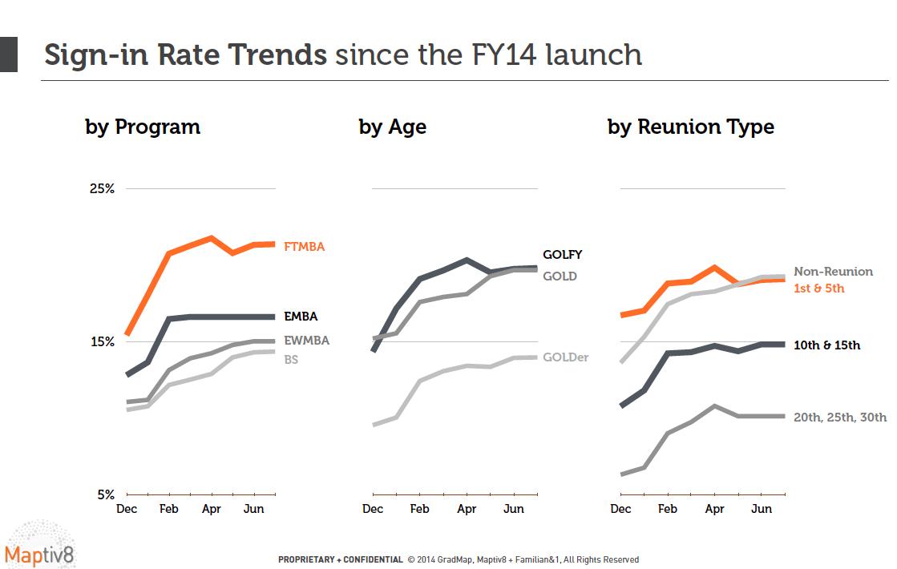
case 2: Haas + GradMap
Notes:
30-second history of GradMap
Micro + Haas-branded community
Engagement + fundraising + communication
[awaiting slides from Seth]

Slide 10
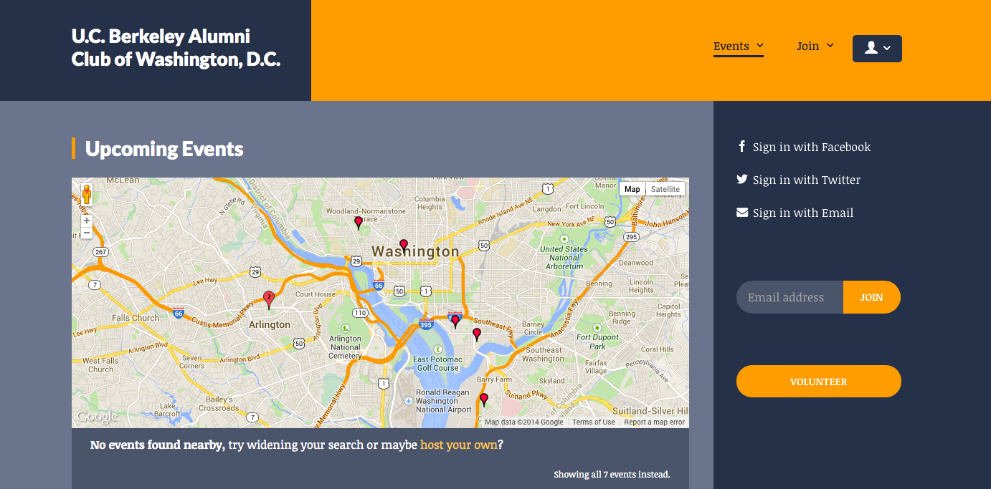
case 3: Berkeley + NationBuilder
dccalalumni.nationbuilder.com
Notes:
Goals: independently-managed regional chapter websites.
Event Management
Directory function
Communication function
Eventually a fundraising component (both mass campaign and peer campaign)

Slide 11
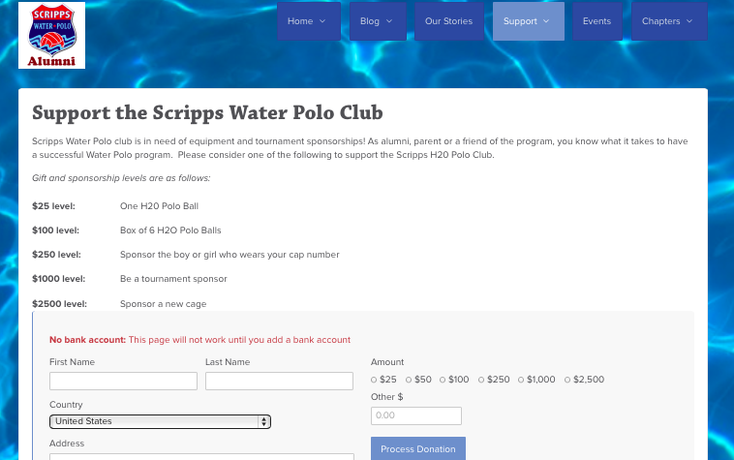
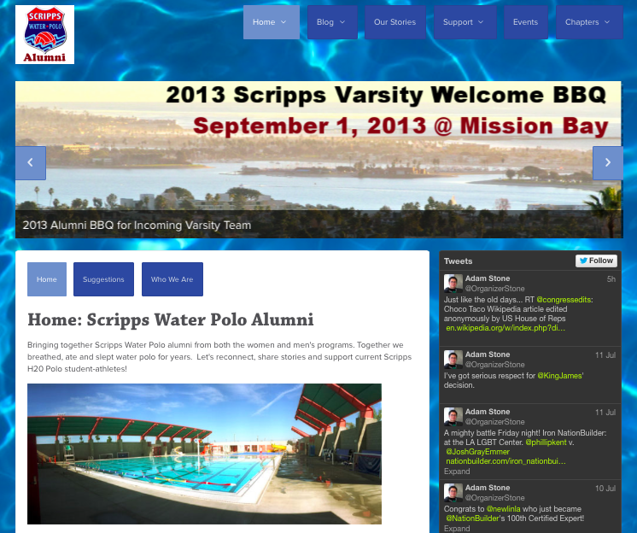
case 3: Berkeley + NationBuilder
organizeradamstone.nationbuilder.com
embedded giving site
nation landing page
Notes:
Goals: independently-managed regional chapter websites.
Event Management
Directory function
Communication function
Eventually a fundraising component (both mass campaign and peer campaign)

Slide 12
Alumni Engagement Tools
Looking to the future
How do alumni want to use the information from our database?
Connect with alumni based on:
Current location
Personal, professional, school interests
Past work experience
Personalized connections to others in the alumni community
How does social media help alumni relations and not compete with it?
Do you need different tools for different segments?
Is email still a viable communication tool?

Slide 13
appendices
Contacts
GiveGab presentation (available in online version only)
NationBuilder presentation
About Quadwrangle (UNC Kenan-Flagler assessment)
About EverTrue (UNC Kenan-Flagler assessment)

Slide 14
appendix – contacts
GradMap QuadWrangle
Seth Familian, Founder Nick Zeckets, CEO & Co-founder
seth@maptiv8.com nzeckets@quadwrangle.com
Givegab EverTrue
Charlie Mulligan, Founder Jesse Bardo, Alumni Engagement
charlie@givegab.com jesse@evertrue.com
NationBuilder
Adam Stone, Organizer
astone@nationbuilder.com
,

Slide 15
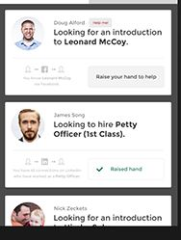
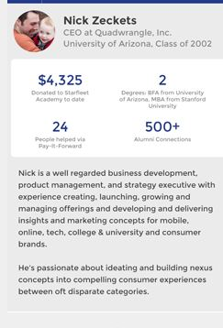
appendix – QuadWrangle
App and soon to have desktop availability
Front-end and back-end app
Updates to database when updated from phone or LinkedIn. No permission issues.
Personalized newsfeed based on direction from school and info we have on alumni.
Software curates the information
Users can share content easily
Great backend info for campaigns or development
Customized action button for each “article” the directs person to what you want i.e. support, volunteer, etc.
Great analytics too by the aggregate or by the individual
Useful way to promote blogs and drive people to them
Class Ring – good networking, career help, facilitate connection, not guilt if not interested in connecting, easy way to get people introduced to each other

Slide 16
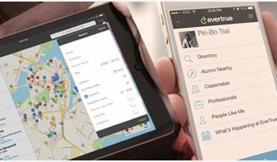
appendix – EverTrue
Strongly connected to LinkedIn
Fundraising component
EverTrue app is for:
Alumni Relations
Data Team
Alumni
Giving Tree app is for:
Advancement Office
Fundraisers
Prospect Research
Alumni Relations
App only, no desktop availability
On the app:
Shows alumni nearby
Professionals to know
Classmates
News and SM feeds
Alumni Directory
Preferred address fields are designated by school in the format we want
Can accommodate smart sites – designate the specific alumni to access or who can access what.
Grow professional network, look at work history with LinkedIn. All integrated.
Name, Email or LinkedIn log in.

