Slide 1

So, you want to become an
a c c o u n t a n t ?
Well, we have a program for you!
Ed Babcock | October 15, 2018

Slide 2
Accounting | The Language of Business
Mathematical ability helps, but accounting is mainly careful reasoning and precise communication.
Progressive Emphasis in Curriculum
What and How
Technical skills and understanding the language matter
Why
Emphasis on application of the How
It requires the discipline to study and work honestly, accurately, and steadily. Learning for the long-term!
But the benefits are well worth the cost.

Slide 3
Job opportunities
Public Accounting (Assurance, Advisory, Tax)
Internal Auditing and Risk Assessment
Not-for-Profit Accounting
Law Enforcement
(i.e., FBI)
Consulting
Government Accounting
Financial Management
and Controllership
Corporate Accounting, Corporate Finance, Cost Control, Budgets & Planning, Performance Measurement, Treasury – Cash & Capital Management
Graduate School, Teaching, and Research

Slide 4
So what do employers say about PSU Accounting students?
Problem Solvers
Excellent Communicators
Hardworking
Engaged
Multitaskers
Strong Character
Critical Thinkers
Technically/
Analytically Adept
Integrity
Honest
Creative
Leaders
Financially Savvy
Team Oriented
High Ethical Values/Morals

Slide 5
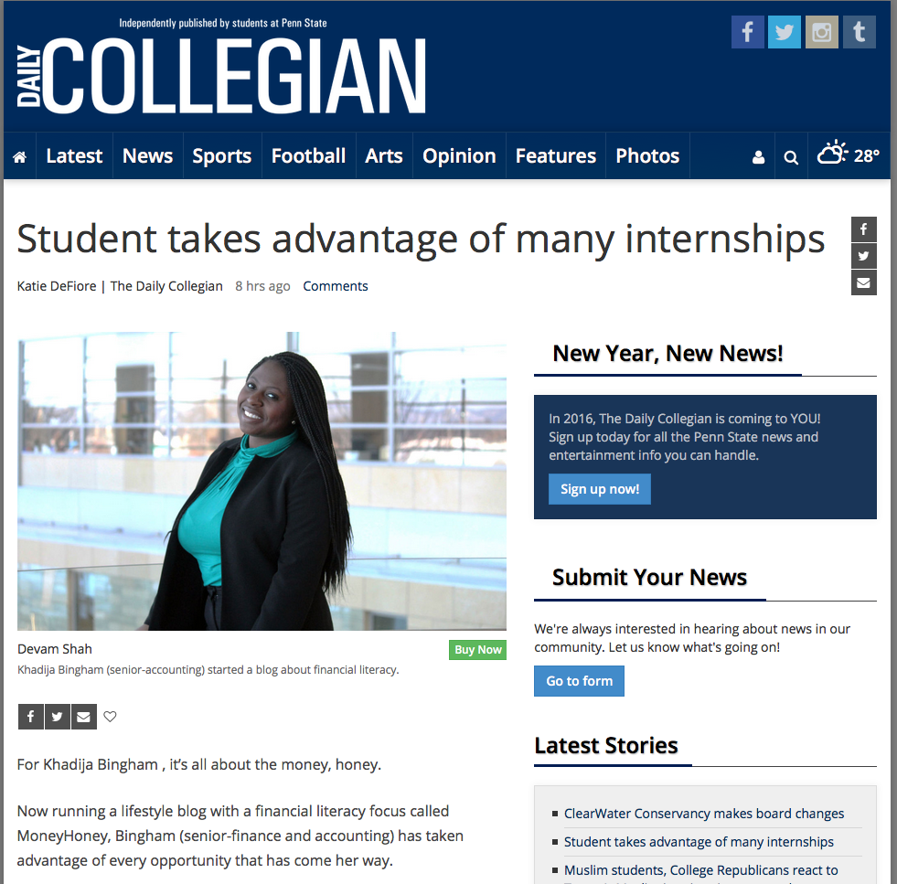
Internships are Highly Recommended
Many paid public accounting and corporate internships are available and desirable
Internships vary by program and
are generally available in spring
and summer
There is no guarantee of an internship

Slide 6
Many post-graduation certifications
CMA
CIA
CISA
CPA
Certified Management Accountant
Certified Internal Auditor
Certified Information System Auditor
Certified Public Accountant (professional license)
Some accountants have no professional certifications.

Slide 7
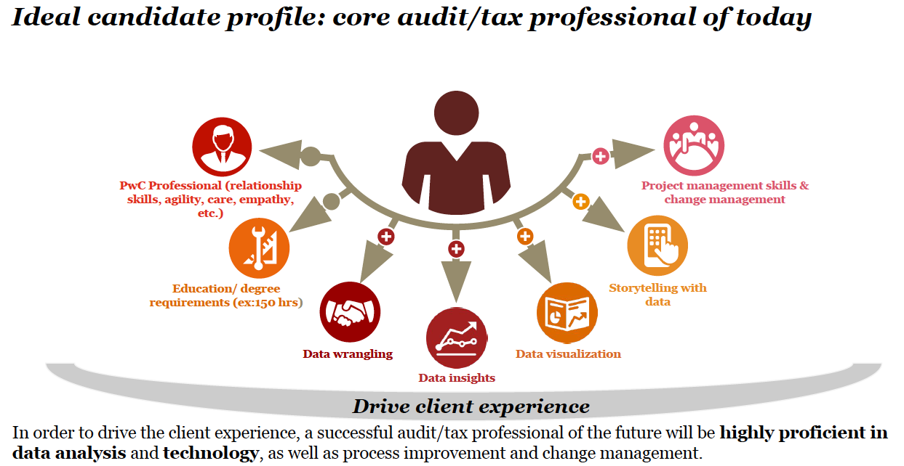
Technology in Accounting
The landscape is changing quickly – that translates to opportunity for you.

Slide 8
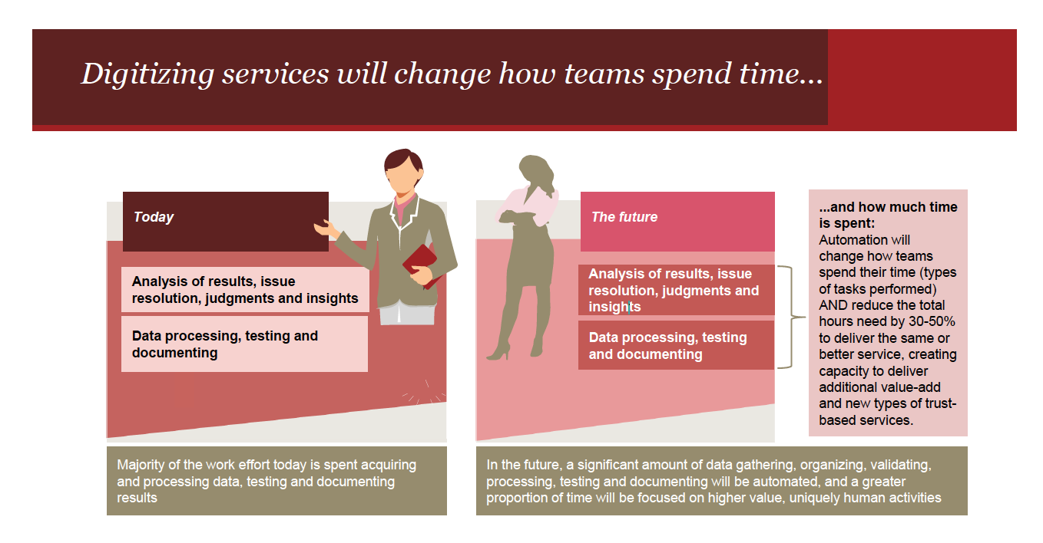

Slide 9
So how can I achieve my dream here at Penn State?

Slide 10
Two Degrees, Many Career Paths
Bachelor of Science in Accounting
  Corporate Control and Analysis Certificate
  Internal Audit and Assessment (stay tuned)
Master of Accounting
  Integrated Master of Accounting (2+3)
  One-Year Master of Accounting (4+1)
  Information Systems Management (“ISM”) minor is a great addition to your Accounting degree
Bachelor of Science in Accounting
Master of Accounting

Slide 11
Bachelor of Science in Accounting
Required Accounting Courses
ACCTG 403W
Auditing
ACCTG 405
Principles of Taxation
ACCTG 472
Intermediate Accounting II
ACCTG 404
Managerial Accounting
ACCTG 471
Intermediate Accounting I
Electives
Choose two additional 400-level ACCTG courses

Slide 12




Developing a Digital Mindset
Increased emphasis in curriculum on learning and leading in a digital world.
Courses integrate content with intellectual curiosity
and relevant technologies and digital resources
Increased emphasis on data analytics
Science of examining raw data in order to draw conclusions about information

Slide 13
Corporate Control and Analysis https://www.smeal.psu.edu/accounting/programs/cca
Application for current sophomores majoring in accounting
Graduate in 4 years with a BS in Accounting
Receive CCA certificate, mentioned on transcript
CMA (Certified Management Accountant) exam by the time you graduate
Complete an internship
Study-abroad is possible
Develop strong non-curricular business related skills
AND in future…
CPA (Certified Public Accountant) Exam
  CGMA (Chartered Global Management Accountant)

Slide 14
Requirements of the CCA Certificate
Apply with a GPA > 3.4 in the following courses
ACCTG 211
MATH 110
or 140
STAT 200 or SCM 200
ECON 102
A path through the Smeal undergraduate major in dedicated sections of the following courses
ACCTG 404
Managerial Accounting
ACCTG 417
Corporate and Managerial Comms
ACCTG 440
Advanced Managerial Accounting
ACCTG 481
Financial Statement Analysis
An approved internship

Slide 15
Corporate Control and Analysis Placement
INDUSTRY
EMPLOYERS
Goldman Sachs, Johnson & Johnson, IBM, The Prudential, US Steel,
Marriott, JPMorgan Chase, PPG, BNY Mellon, Goldman Sachs,
PNC, Eaton, ExxonMobil
CONSULTING
EMPLOYERS
Deloitte, PwC, RSM, EY, KMPG, BDO
TYPES
OF JOBS
Financial Analyst, Budget Analyst, Cost Analyst,
Cost Accountant, Internal Auditor, Consultant
PROGRESS
TOWARDS
CAO, Controller, CFO, & CEO

Slide 16
Pay Progression for CMAs
CMAs
31% more
Noncertified
In the United States, CMAs earn 31% more in total compensation than their noncertified peers.
Source: IMA Global Salary Survey, www.imanet.org/salary_survey

Slide 17
Public Accounting
Become a CPA and join a broad-ranging, prestigious, licensed profession
Must satisfy the “150 credit-hour” requirement
Get there with Penn State’s Integrated or One-Year
Master of Accounting (MAcc) Program
30 additional credit hours designed to meet the 150 credit-hour requirement in most states

Slide 18
Work Hard and The Jobs are Plentiful
Major Recruiters
  Public Accounting Firms
  Investment Banks
  Industry
  MAcc Program recognized as top source
  of talent for many major employers
Placement rates are extremely high with top employers
  Wall Street Journal noted Penn State as top school for recruiters
  Penn State in top 3 for sources of talent for all major public
  accounting firms
Rough Starting
Salary Ranges
  $50k-$70k (location dependent)
  More with IT

Slide 19
Integrated MAcc
Application for current sophomores majoring in accounting opens between Dec 2018 to mid Jan 2019
Features
  Mixture of graduate and undergraduate courses over the junior, senior, and 5th year
  Opportunity to complete an internship
  Study-abroad is possible
  Graduate with both a Bachelor and Master degrees, meet the 150 credit-hour requirement, be ready to sit for the CPA Exam
  Graduate GPA must exceed 3.0
  Generally can complete the Program in 9 tuition paying semesters, all at UG tuition rates with one-time $4,750 graduate tuition differential (very cost efficient for a Masters degree)

Slide 20
Undergraduate Degree + One-Year MAcc
5
Prerequisites
ACCTG
211
ACCTG 404
ACCTG 471
ACCTG 403W
ACCTG 405
ACCTG 472
Y E A R S
2
A program, not a collection of courses
Dedicated course sections, including communications and finance
Meaningful networking and professional development opportunities
Built-in internships
Top notch faculty leading courses
DEGREES

Slide 21
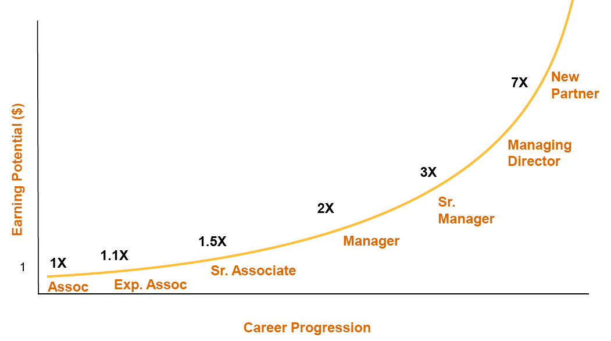
Pay Progression
Source: PwC Faculty Symposium, August 2011

Slide 22
Graduate School
Law School
Tax and Securities Law Specializations
JD and LLM in Tax
PhD Programs in Accounting
Become a Professor!

Slide 23

Professional Connections and Growth
Over 39,000 LinkedIn profiles affiliate with “Penn State accounting”
Broken down by current
job function
Many different career paths

Slide 24
Accounting Student Organizations
Accounting Society
  http://psuaccountingsociety.weebly.com
Beta Alpha Psi
  http://pennstatebap.weebly.com
Corporate Control & Analysis Club
  http://ccapsu.weebly.com/
Master of Accounting Program Student Association
  http://www.psumpsa.org
Volunteer Income Tax Assistance (VITA)
  http://www.psuvita.org/

Slide 25
Penn State Among Top Producers of S&P 500 CEOs
(Bloomberg BusinessWeek 05/13/2010)
7
of the CEOs count Penn State as their undergraduate
alma mater
1
1
Penn State
tied for
th
on the list with Cornell
Notre Dame
and UPENN
http://www.businessweek.com/magazine/content/10_21/b4179020050124.htm
http://news.smeal.psu.edu/news-release-archives/2010/june-2010/penn-state-among-top-producers-of-s-p-500-ceos

Slide 26
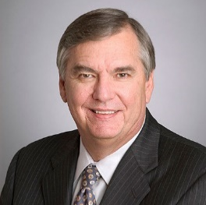
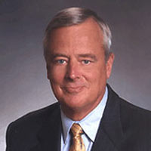

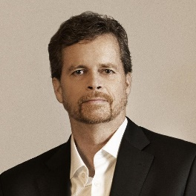
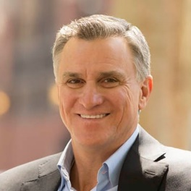
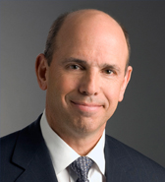
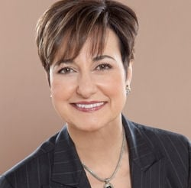
Bloomberg News: Most of the Penn State CEOs come from the accounting department
Michael Laphen
Chairman, President, and CEO of Computer Sciences Corp
Laphen graduated from Smeal in 1972 with a bachelor's degree in Accounting
Albert Lord
Vice chairman and CEO of SLM Corp
Lord graduated from Smeal in 1967 with a bachelor's degree in Accounting
Gregory Lucier
Chairman and CEO of Life Technologies Corp
Lucier graduated from Penn State in 1986 with a bachelor's degree in Industrial Engineering
Mark Parker
President and CEO of Nike Inc
Parker graduated from Penn State in 1977 with a bachelor's degree in Political Science
Walter Rakowich
CEO of ProLogis
Rakowich graduated from Smeal in 1980 with a bachelor's degree in Accounting
John Surma
Chairman and CEO of U.S. Steel Corp
Surma graduated from Smeal in 1976 with a bachelor's degree in Accounting
Patricia Woertz
Chairman, President, and CEO of Archer Daniels Midland Co
Woertz graduated from Smeal in 1974 with a bachelor's degree in Accounting

Slide 27
So, you want to become an
a c c o u n t a n t ?
So what questions
do you still have??
Ed Babcock | October 15, 2018

Slide 28
A Perspective From One of Our Primary Employers
All major employers are increasingly looking for a combination of technical competency in accounting and increased technology acumen in the tools used for assessment.
Critical thinking and problem solving are the “main thing”.
https://www.youtube.com/watch?v=SnD1A75j_dY
But you still need to know the language of business.

